Slide 1
Autonomous Assistive Robot with dynamic navigation and person tracking
Team D05:
Rangala Kartikeya
Tanguturi Vinay Krishna Chetty
Sai Kartikeya Vasireddi
Sai Akhilesh Y
CB.SC.U4AIE23333
CB.SC.U4AIE23341
CB.SC.U4AIE23345
CB.SC.U4AIE23348

Slide 2
Problem Statement and objective:
Many environments require autonomous assistive robots to assist individuals in navigation and tracking.
Existing solutions lack dynamic adaptability, struggle with real-time person tracking, or fail in complex indoor environments.
A reliable assistive robot must efficiently perceive surroundings, track individuals, and navigate safely.

Slide 3
So, we are trying to:
Develop an autonomous assistive robot that can:
Navigate dynamically in real-world indoor environments.
Track and follow individuals while avoiding obstacles.
Process sensor data for intelligent decision-making.
Web application for Human-Robot Interaction, communication and reminders.
Speech to text conversion.

Slide 4
Literature Review:
Paper | Authors | Date | Summary
Development of a Low-Cost Autonomous Healthcare Digital Assistant Lead RoBot (DALBOT) | Abdullah Mujahid; Akhtar Kalam; Seyed Morteza Alizadeh; Yuanyuan Fan | 27 March 2023 | This paper discusses DALBOT, a low-cost autonomous healthcare robot designed to guide patients in medical facilities. Equipped with navigation using Cartesian coordinates, it integrates with systems like stretchers, wheelchairs, and medical supply deliveries.
Assistive and Service Robots for Health and Home Applications | Paloma de la Puente, Markus Vincze, Diego Guffanti, Daniel Galan | 29 October 2024 | This article explores smart healthcare assistants powered by conversational AI, including chatbots and voice devices, for tasks like symptom checking and medication reminders. It also discusses AI integration from companies like Microsoft and Amazon.
Assistive Technology for Elderly Care: | Ester Martinez-Martin; Angelo Costa | 25 June 2021 | This paper provides an in-depth look at assistive robotic technologies designed for elderly care. It explores robotic solutions for mobility support, medication reminders, and emergency response in home and hospital settings

Slide 5
Paper | Authors | Date | Summary
Robots in Healthcare: a Scoping Review | Ahmed Ashraf Morgan, Jordan Abdi, Mohammed A. Q. Syed, Ghita El Kohen, Phillip Barlow & Marcela P. Vizcaychipi | 22 October 2022 | This paper examines the robots in healthcare, explaining roles in surgery, and patient care. It highlights ten key functions, with a focus on surgical assistance and mobility support, and discusses how COVID-19 accelerated robotic solutions' adoption.
A Review of Emotions Recognition via Facial Expressions for Human-Robot Interaction | Ali Hussein Mousa; Asia Mahdi Nasser | 21 May 2024 | This paper highlights emotion recognition (ER) in HRI, focusing on things like facial expressions, voice, and physiological signals. It discusses ML models like CNNs and RNNs for extracting and classifying emotions from facial features.
Assessing Emotions in Human-Robot Interaction Based on the Appraisal Theory | Marco Demutti; Vincenzo D’Amato; Carmine Recchiuto; Luca Oneto; Antonio Sgorbissa | 30 September 2022 | This paper focuses on socially assistive robots (SARs). It integrates cognitive appraisal theory to improve emotional understanding by considering individuals' needs and goals alongside inputs like facial expressions and speech.
Audio and Video-based Emotion Recognition using Multimodal Transformers | Vijay John; Yasutomo Kawanishi | 29 November 2022 | This research uses multimodal transformers to recognize emotions from audio and video inputs, improving accuracy by combining both modalities. It demonstrates superior performance over traditional methods

Slide 6
Paper | Authors | Date | Summary
Enhancing Human–Robot Interaction: Development of Multimodal Robotic Assistant for User Emotion Recognition | Sergio Garcia,Francisco Gomez-Donoso and Miguel Cazorla | 18 December 2024 | This paper explores “multimodal” ER in HRI using the humanoid robot Pepper. It combines visual, auditory, and textual data to enhance emotion detection accuracy, leading to more personalized interactions in assistive and educational environments.
Multimodal Emotion Recognition Using Deep Learning: A Survey and Future Directions | Hiranmayi Ranganathan; Shayok Chakraborty; Sethuraman Panchanathan | 26 May 2016 | This paper examines deep learning techniques for multimodal emotion recognition, combining facial expressions, speech, and physiological signals. It highlights the use of deep neural networks to enhance emotion detection accuracy in real-world settings.
The Role of Healthcare Robots for Older People at Home: A Review | Lara Toledo Cordeiro Ottoni and Jés de Jesus Fiais Cerqueira | 16 October 2024 | This paper reviews HRI with emotional engagement, emotion recognition and expression in robots. It highlights challenges in communication, autonomy, and user-centered design, and discusses emotion models i.e. Ekman’s basic emotions and the OCC model.

Slide 7
Research Gap:
High costs and infrastructure limitations hinder widespread adoption of healthcare robots.
Navigation and mobility challenges affect robot efficiency in medical facilities.
Limited accuracy in monitoring patient movements impacts assistance and safety.
Lack of adaptability to diverse patient needs hinders personalized care.
No Specialized care.

Slide 8
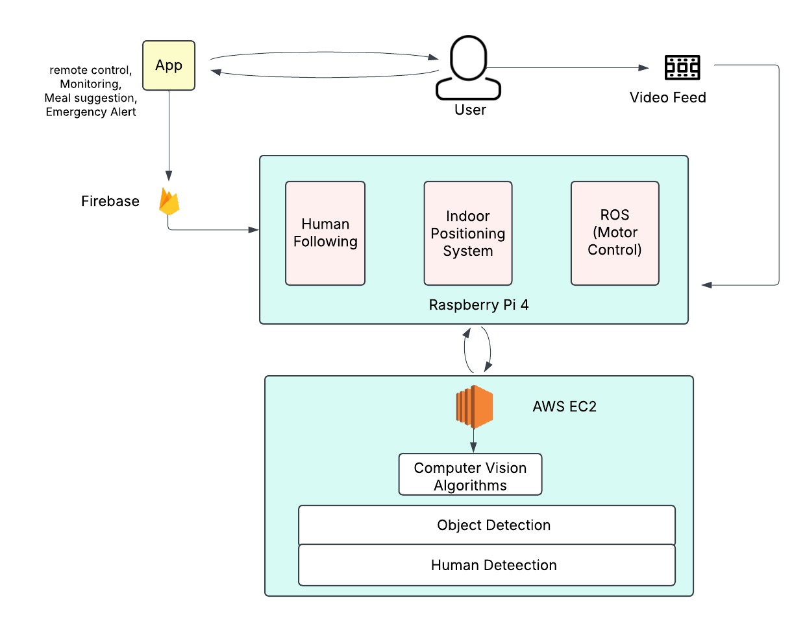
Proposed method:

Slide 9
Implementation of our project:
Software Implementation:
Live Feed
Remote Movement in the Application
Hardware Implementation:
Autonomous Tracking a person through complex indoor systems
Speech to text

Slide 10
Implementation we have completed:
Software Implementation:
We have Successfully implemented a sign up page to sign up and create an account in the Web application
We have created a database connection to the web page to save login info to sign in again.
We have created a web page UI to have two types of tracking
One is with Remote control from the Web application
One provide the person tracking Live feed (To be Done).
Created a connection between the Raspberry pi and database and the information is being passed through.

Slide 11
Implementation to be done:
Hardware Implementation:
We need to implement the Person tracking for the robot.
Provide live video feed in the web application and get as less latency and much frames as possible.
Develop a web-based interface to send movement commands to the robot.
Ensure seamless navigation through manual or automated controls.

Slide 12

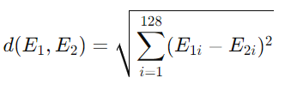
Face Encoding & Recognition (128-Dimensional Vector Representation)
The system converts a face into a 128-dimensional vector using a Convolutional Neural Network (CNN).
Feature Extraction using Convolution:
(i,j) = Input image pixel
K(m,n) = Filter (Kernel)
Y(i,j) = Output feature map
The ReLU activation function introduces non-linearity:
f(x)=max⁡(0,x)
The fully connected layers reduce the features to a unique 128-dimensional encoding:
E=(E1,E2,...,E128)
Face Matching Using Euclidean Distance
The system compares faces using the Euclidean Distance:

Slide 13
Different Phases of the Project:
Week 1: Planning and Component Collection
Week 2: Environment Setup
Week 3: Web Application Development - Frontend
Week 4: Web Application Development - Backend
Week 5: Person Tracking and Object Detection
Week 6: System Integration and Testing
Week 7: User Feedback and Iteration
Week 8: Finalization and Deployment

